Slide 1


Solution By: Endgame
PSID: INTL-NLP-11
Team Leader Name:
Ankit Kumar

Slide 2

Idea Introduction
IDEA TITLE- BASELINE
Tech Stack
1. Python
2. NLP
3. Deep Learning
Resources Used
1. IEEE Papers
2. NPTEL
3. python.org
4. Statistical Inference by George Casella
Any Third Party API/Services used
Yes
ABSTRACTION-BASED TEXT SUMMARIZATION
Our solution produces a short and accurate summary from a large number of news articles on terrorism using the abstractive summarization method. By conserving significant information this approach produces an effective summary having less redundancy and more grammatically correct sentences within a short period of time.

Slide 3

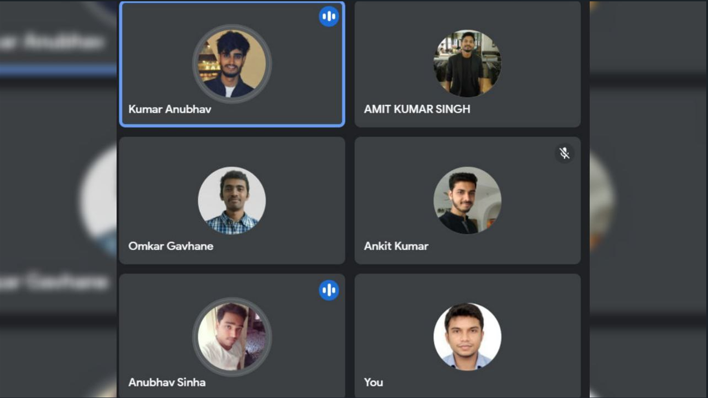
Your Approach Towards Idea
Approach:
- Collection of news article related to terrorism.
- Build a model to generate summary.
- Calculate Accuracy and remodel accordingly.
- Model will generate summary of new article.
We have considered the given problem as an application of deep learning and NLP.
We will build a model that will generate a concise and unbiased summary capturing all salient aspects of the source text.
The same model can be used to generate a summary from audio files in both formats i.e. text and audio.
Notes:
Use any image of your proposed solution here instead of this macbook image

Slide 4






Team Slide
Ankit Kumar
IIT Patna
Kumar Anubhav
IIT Patna
Atul Prakash
IIT Patna
Anubhav Sinha
IIT Patna
Omkar Santosh Gavhane
IIT Patna
Amit Kumar Singh
IIT Patna

Slide 5
Development Pipeline
Documents To be prepared for installation and evaluation
1. SRS Document
2. Test Document
3. Source Code Document
4. Help Manual
5. Reports and Metrics
Any Third party API used, if yes please specify
1. TensorFlow API 2. Beautiful Soup
Proposed Development Plan in pointers
1. Literature survey and dataset creation
2. Data Pre-processing
3. Model Building
4. Testing
5. Model refinement
6. Further improvements
Repository Link or Any references link of folders
https://github.com/asr8271/Manthan_2021
Proposed UI and functional flow in pointers
1. Give inputs
2. Give desired length of output
3. Save generated summary or copy it.
4. Feedback
5. Quit
Step A
Step B
Step C
Step D
Step E

Slide 6
Vision of Innovation/Idea/Solution
Explain How you developed Idea.
Answer : After analysing the problem statement, we gathered information from various sources(research papers, NPTEL videos) and extracted relevant information that helped us in developing the idea.
Any early stage innovation detected while developing the solution.
Answer : In early-stage, we found that data pre-processing and mathematical manipulation on this data solves most part of our problem.
How your idea is different and innovative form other ideas- a default comparison?
Answer : We are building an abstractive summarization model for multiple inputs/documents which will generate a semantically correct short and concise summary, without being biased towards any source while already existing models work for single input and mostly uses an extractive method for summarization.
Further, we are in plan to improvise our system to work with audio input as well.
.
How much time it will take in conversion as a final product?
Answer : 1.5 Month (Approx.)

